Slide 1


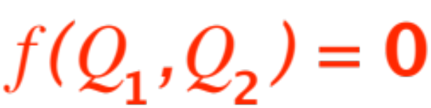
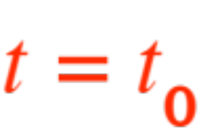

RELATED RATES
Recall the second “situation” we still have to address, namely:
Situation no. 2: Two quantities and are
related to each other via some formula
Suppose we know the rate of change of one of them (either one, for ease of thought say ) with respect to time, at some known time
(or for some known value of ). We ask:
What is the rate of change of at that time?
Notes:
, …

Slide 2

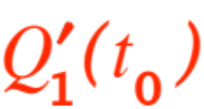

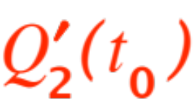


Let’s analyze the situation in details. The “givens” are:
that is, we know the formula
or
that is, we are given a number.
The requested answer (what we have to find) is
It is essential that we clearly identify in our minds what and are, respectively.

Slide 3
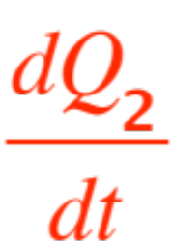
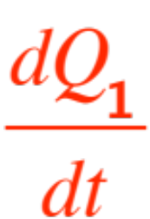
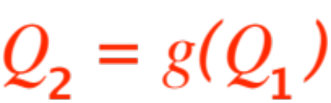
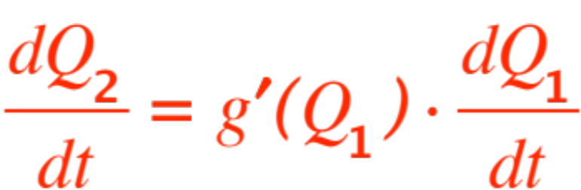
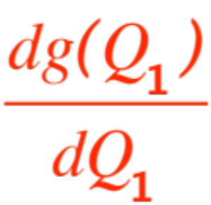
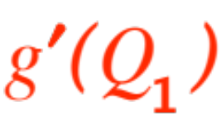
Remark. If the given formula is nice enough we may be able to compute in terms of directly. For example, if the formula looks like
then we have
Where just means
Let’s look at a couple of examples.

Slide 4



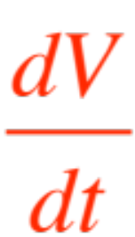

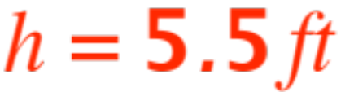
Example 1. (A version of a “nice” formula)
A cylinder has radius and height .
Let denote the volume of the cylinder.
Express in terms of when
is constant, say (ring any bell?)
Solution. (READ THE ADVICE ON p. 179 OF THE TEXTBOOK !!)
Here is the suggested diagram.

Slide 5
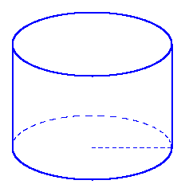


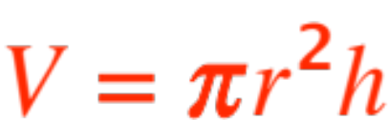
The “nice” formula is
So we get (remember, )

Slide 6
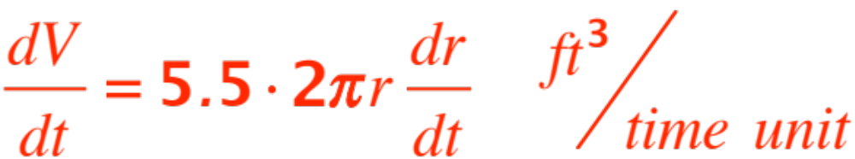

( OK? )
which means that, for example, when the circum-ference of the base is 41 inches, an increase in the radius of one inch per unit of time corre-sponds to an increase in the volume of 225.5 cubic inches per unit of time (figure it out, when the circumference is 41, is …… )
One more example.

Slide 7



A boat is traveling along a straight east-west line
A lighthouse is located 3mi north of the line .
Express the rate of change of the distance between the lighthouse and the boat in terms of the velocity of the boat.
When the boat is 4mi west of the lighthhouse it is traveling eastbound at
Is incresing or decreasing?, how fast?
Solution. Draw a diagram!

Slide 8
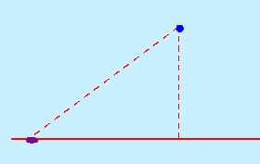






Here it is (obvious notation):
The quantities that change here are and

Slide 9

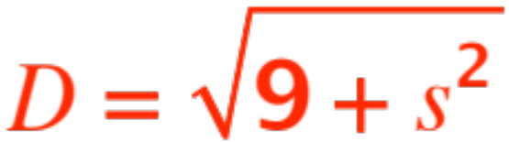
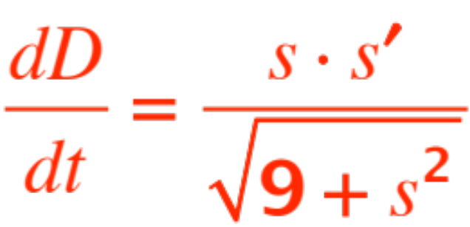

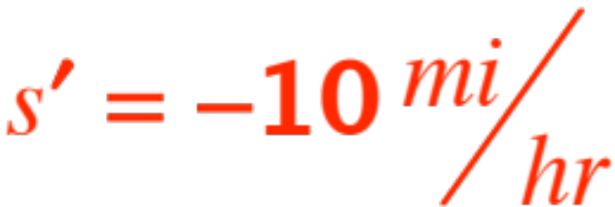
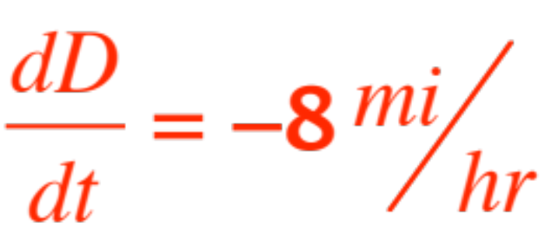
Set
Then
and (answer to no. 1)
Also,
When the boat’s velocity is
(why?)
Therefore
which answers question 2.

Slide 10


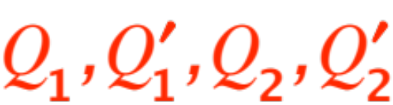
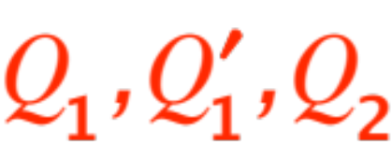
In the general case, when the formula is not so nice and looks just like
we proceed as follows (after a diagram!)
Take the derivative of with respect to
(remembering that both quantities are
functions of and therefore applying the
chain rule appropriately).
The resulting expression will have
appearing. The problem will give us three of the four, usually
and we solve for the fourth one.

Slide 11
Now we do problems from the textbook. Here is one (modified):
My sister owns a villa in Tuscany where her son plans to build a rectangular swimming pool, 10m long and 6m wide. The bottom of the pool, moving along its length, has the following depths (starting at one end):
Drops linearly 1m in 2m displacement, then
Drops linearly 4m in 2m displacement, then
Stays level for 5m displacement, then
Rises linearly to 0m depth.
Here are the question:

Slide 12
Once built, my nephew will fill the pool pumping in water at a constant rate of 5,000 liters/min.
How fast will the water level be rising when
The deepest depth is 3m ?
The deepest depth is 4m ?
The deepest depth is 4.5m ?
How long will it take him to fill the pool ?
Let’s go to work, following the book’s excellent advice given on p. 117.
Here is the pool’s cross-section (lengthwise)

Slide 13
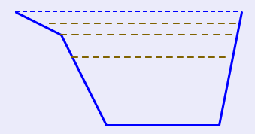

We sketch
The three brown levels are the ones we are interested in. We re-sketch with the pertinent data and variable height .

Slide 14
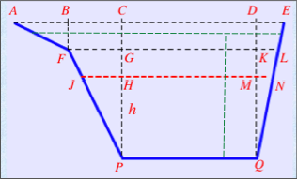
Here we go:
There are two cases to be considered:

Slide 15
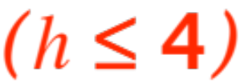
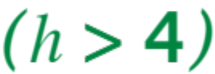
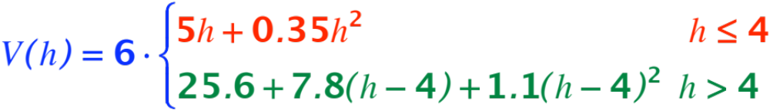
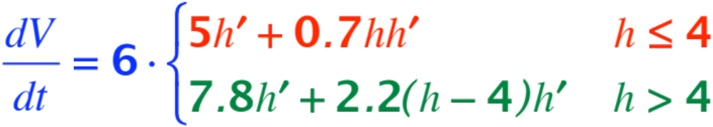
The red case and
the green case . From judicious applica-tion of geometry (areas of triangles and trape-zoids) we get
Therefore

Slide 16
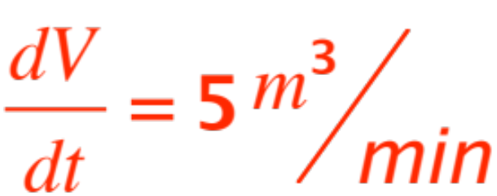
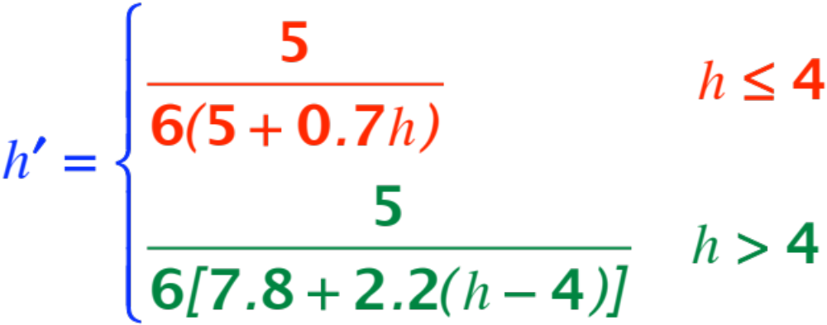


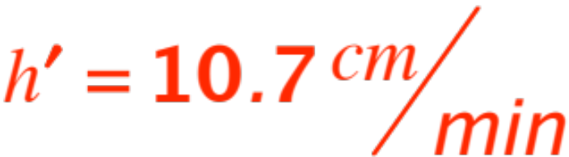
Since we know (1 cubic meter = 1,000 liters!)
we obtain
Note that is continuous at , in fact when
we have

Slide 17
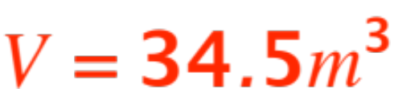

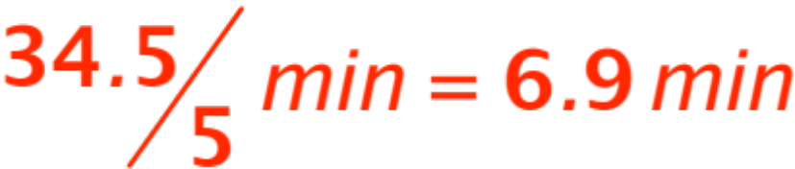
Recall the questions
How fast will the water level be rising when
The deepest depth is 3m ?
The deepest depth is 4m ?
The deepest depth is 4.5m ?
How long will it take to fill the pool ?
The first three are now easy to answer. For the last one, from the green case in the formula for the volume we get (setting )
Therefore it takes to fill the pool. (One very fast pump !)

